Slide 1


U.S. Elections and S&P 500 Performance
DSC 680 - Applied Data Science
Professor Amirfarrokh Iranitalab
Project 2 Milestone 3
By Gabriel Vance
February 2026

Slide 2
Background / Context
The S&P 500 is a benchmark for U.S. equity performance and reflects sentiment, inflation, employment, crises, and wealth creation.
U.S. federal elections occur every 2 years and can shift party control.
This study examines whether election timing and party alignment are associated with next-year market returns.

Slide 3
Business Problem and Objective
Goal: test whether election cycles and presidential party are useful signals for S&P 500 performance.
Question 1: Do non-election, midterm, and presidential years show different return patterns?
Question 2: Are returns meaningfully different under Democratic vs Republican administrations?
Outcome: quantify correlation, not trading advice.

Slide 4
Data Sources and Preparation
S&P 500 prices: yfinance symbol ^GSPC.
Returns: January-to-January year-over-year performance.
ELECTION labels: manually curated from 270toWin historical election maps.
Join key: year, then merge return series with election-cycle and party labels.

Slide 5
Election Cycle Grouping
Study window starts in 1950.
Year groups:
- 38 non-election years
- 19 midterm years
- 19 presidential years
These groups are compared with descriptive statistics and distribution plots.

Slide 6
Cycle-Level Return Patterns
Boxplots summarize distribution by election cycle.
Non-election years show the strongest average performance.
Midterm and presidential years have lower central tendency and wider dispersion.
Result: cycle timing appears correlated with expected return levels.

Slide 7
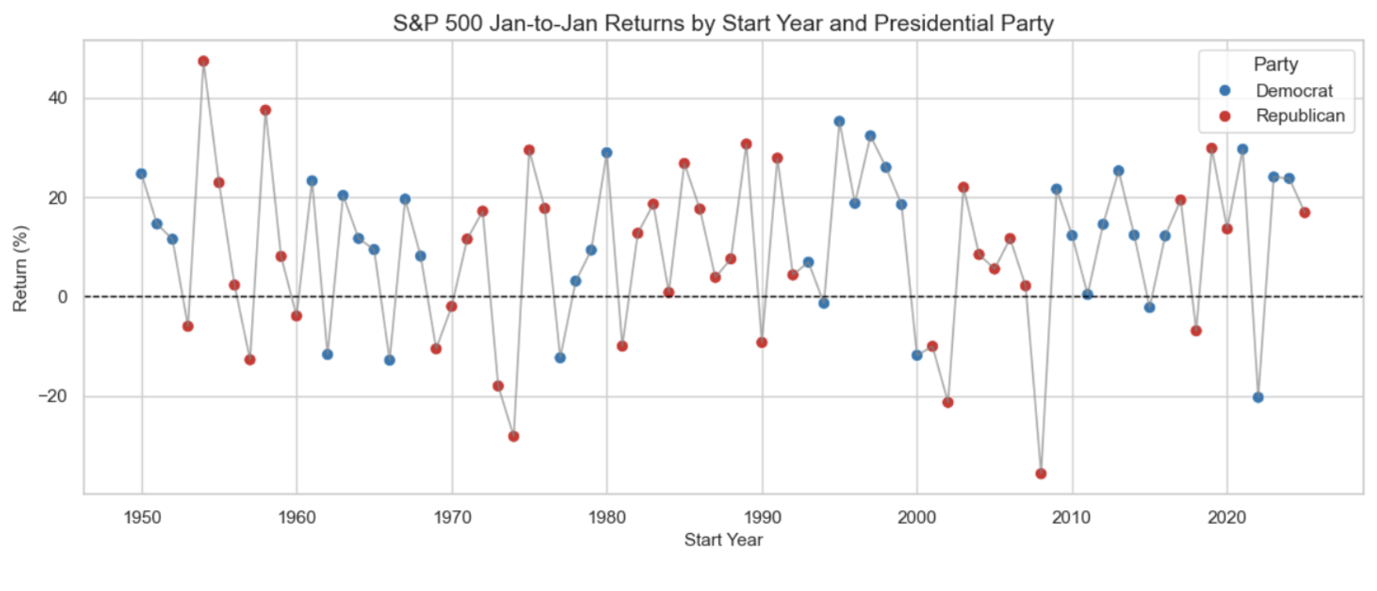
Returns Over Time by Party
Line charts of annual returns by party show high volatility and noise.
No consistent return edge appears for either party across decades.
Large drawdowns around 2000, 2008, and 2022 coincide with incumbent-party backlash in elections.
Interpretation: sentiment shocks may influence both markets and voting behavior.

Slide 8
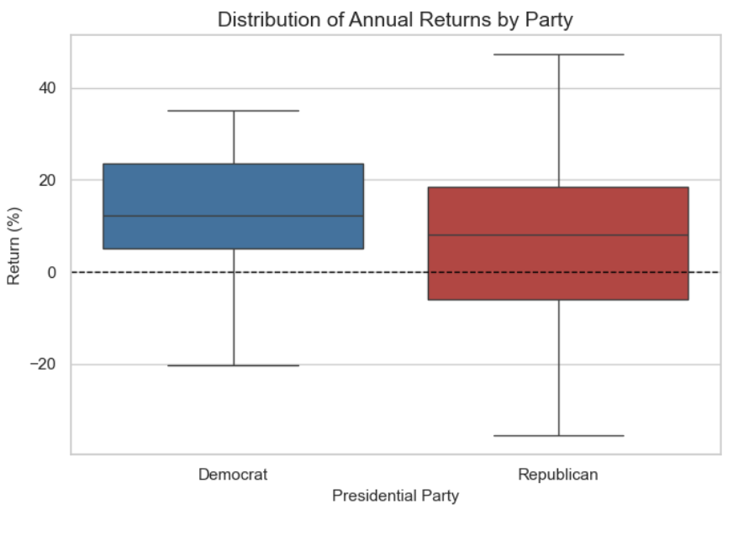
Party Comparison and Statistical Test
Average return by party:
- Democrats: about +12%
- Republicans: about +8%
A t-test produced p = 0.19.
Conclusion: the party difference is not statistically significant at conventional thresholds.

Slide 9
Incumbent-Loss Signal (Exploratory)
Exploratory view: severe market declines may increase odds of "throw the bums out" outcomes.
Potential examples were noted in 2000, 2008, and 2022 cycles.
This is an association, not proof of causation.
Future work should formalize thresholds and test robustness.

Slide 10
Current Cycle Implications (2026)
2026 is a U.S. midterm year.
Historical midterm average return in this study is lower than non-election years.
Recent context:
- 2023: +24%
- 2024: +25%
- 2025: +17.9%
Expectation: moderate returns are plausible, with wide uncertainty.

Slide 11
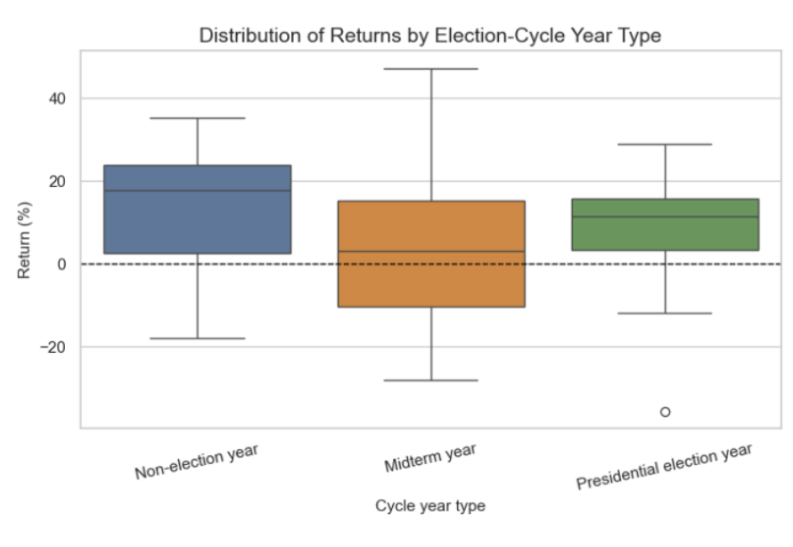
Key Findings Summary
Non-election years average about +12%.
Presidential election years average about +7.8%.
Midterm years average about +4.8% with large variance (about -10% to +18%).
Election-cycle differences appear stronger than party-only differences.

Slide 12
Conclusions
Election timing shows meaningful correlation with return distribution.
Party label alone is weaker and not statistically significant in this sample.
Because data are historical records, measurement assumptions are limited.
The framework is useful for scenario planning, not deterministic forecasting.

Slide 13
Limitations and Responsible Use
Not investment advice: results describe historical relationships only.
Sample size is limited for presidential-cycle inference.
Macro drivers (rates, inflation, recessions, valuations) were not controlled here.
Best use: risk awareness, hedging discussions, and hypothesis generation.

Slide 14
References and Q&A Focus
References from the milestone report:
1. 270toWin historical U.S. presidential elections
2. Capital Group midterm election market charts (2026)
3. PFBT election cycle theory article
4. WT Wealth Management whitepaper (2024)
Anticipated questions:
- Why January-to-January returns?
- How were transition years assigned by party?
- How robust are conclusions after outlier and macro controls?

